Slide 1
Intelligent Data Framework
A Data-Centric Approach

Slide 2

Today’s Common Pain Points
Software Focused
Manual Steps
High Cost for Custom Reporting
Resources required for maintenance and / or change
Duplicative Sources
Poor Data Quality
Notes:
Many of today‘s processes are hard wired into proprietary Agency software applications; resulting in processes that often reflect these common pain points:
1. Propriety data makes sharing or merging data for reports difficult. Consumers spend large amounts of time making the data fit. For example: SF132 Apportionment data is typically sent manually to receiving agencies which causes the agencies to record the apportionment in their financial system manually.
2. Propriety data also means that every agency has to comply with federal reporting requirements, promulgated by the applicable governing bodies, likely has their own unique and proprietary processes and data format to fulfil these requirements, leading to redundant, inefficient and costly reporting across agencies.
3: Non standardized data creates a costly effort for each agency to gain a small amount of insight and creates a costly dependency on the agency to maintain alignment. Reporting is a ‚push‘ idea from each individual software applications. For example: Agency employees spend a significant amount of time manipulating and validating data when received because data formats for common data elements (e.g. USSGL data) are inconsistent
4: Proprietary systems where data, rules and presentation rules are hard wired make it costly to manage changes to reports with a high dgree of manual proacesses, scalability is costly. For example: a few years ago when the SF133 format was updated, each agency had to make changes to their own proprietary reporting process for that report, a process that occurs any time there is reporting change.

Slide 3
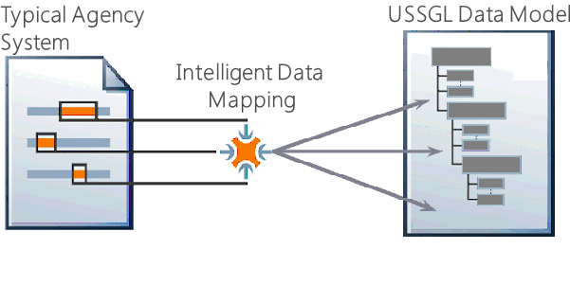
Tomorrow’s Process Enhancements
Transparency
Data Quality
Standardized
Standardized Business Rules
Source Validation
Drill Down and Across
Pull versus Push
“Source of Truth”
Timely
Efficiencies
Collaborative / Reusable
Intelligent Data Framework
Notes:
How is this different:
Standardization of USSGL data via a common data model that is mapped to agency systems – requiring no change in the underlying systems; requiring no change in agency software;
A common machine language for all agencies to communicate their USSGL – with no requirement to use common systems or applications
Basically – bar code for USSGL data concepts that enables the same type of process benefits:
Automation – of report assembly, compilations, more streamlined reconciliations, data exchanges and transfers – and an example we will demo in a min is report assembly of an S133 report from the USSGL data. Also, applicable to data standardization promoting accuracy and completeness. Standardized data enables validation at the source, leading to the consumer being able to spend more time on analysis instead of re-validating the data.
Insights – based on better access to data from disparate systems within your agency and across the supply chain – more timely information on budget to actual and thereby more time available for analytical discovery. More explicit audit trail allows the consumer to understand the source of the data and any changes that have been made inbetween – for example drill downs..
Timely – more timely access to data for inter-agency fund reconciliations, reporting in general, and other cross agency exchanges (need more examples here)
Efficiencies – via the interoperability of different agency systems to more quickly address reporting changes (for example: When reports are updated, agencies can utilize one version of the report in a central library, reports which are shared within the federal financial management community and centrally managed); elimination of reporting redundancies across agencies (for example – library of common reports). Better access and thereby efficiencies by internal and external auditors alike.

Slide 4
Tomorrow’s Process Enhancements
Transparency
Data Quality
Standardized
Standardized Business Rules
Source Validation
Drill Down and Across
Pull versus Push
“Source of Truth”
Timely
Efficiencies
Collaborative / Reusable
Intelligent Data Framework
Notes:
How is this different:
Standardization of USSGL data via a common data model that is mapped to agency systems – requiring no change in the underlying systems; requiring no change in agency software;
A common machine language for all agencies to communicate their USSGL – with no requirement to use common systems or applications
Basically – bar code for USSGL data concepts that enables the same type of process benefits:
Automation – of report assembly, compilations, more streamlined reconciliations, data exchanges and transfers – and an example we will demo in a min is report assembly of an S133 report from the USSGL data. Also, applicable to data standardization promoting accuracy and completeness. Standardized data enables validation at the source, leading to the consumer being able to spend more time on analysis instead of re-validating the data.
Insights – based on better access to data from disparate systems within your agency and across the supply chain – more timely information on budget to actual and thereby more time available for analytical discovery. More explicit audit trail allows the consumer to understand the source of the data and any changes that have been made inbetween – for example drill downs..
Timely – more timely access to data for inter-agency fund reconciliations, reporting in general, and other cross agency exchanges (need more examples here)
Efficiencies – via the interoperability of different agency systems to more quickly address reporting changes (for example: When reports are updated, agencies can utilize one version of the report in a central library, reports which are shared within the federal financial management community and centrally managed); elimination of reporting redundancies across agencies (for example – library of common reports). Better access and thereby efficiencies by internal and external auditors alike.

Slide 5
Intelligent Data Framework
Intelligent Data Framework
Core Financials
Summary Reports w/ Drill Down
Feeder System Data input/capture
Mapping to a Standard
Mapping to a Standard
Reporting
Revenue
Inventory
Grants
Loans
Contracts
Other..
USSGL
Funds Control
Receivable/Payments Mgmt.
OMB
Treasury
Public
Congressional
Program/Managerial Support
Increasingly more summarized information
Notes:
The pilot demonstrates capabilities we would gain from both a business and IT perspective as well as how we would implement it (best practices)
The approach also focuses on a phased approach to the governance and structure of our information assets with a focus on enhancing legacy systems and provisioning of new systems only when needed, it provides the foundational process to enhance our technology capabilities without heavy investment in changing them out.

Slide 6
Mapping to a Standardized USSGL
Agency Financial System
Org
Allocation_xfer_Agency_ID
Beg_POA
End_POA
Mainaccountcode
Sub_acctcode
FY
Fiscal_month
…
USSGL Standard
Organization
Allocation Transfer Agency ID
Fiscal Period
Year
Month
Period of Availability
Beginning
Ending
Main Account Code
Sub Account Code
…

Slide 7
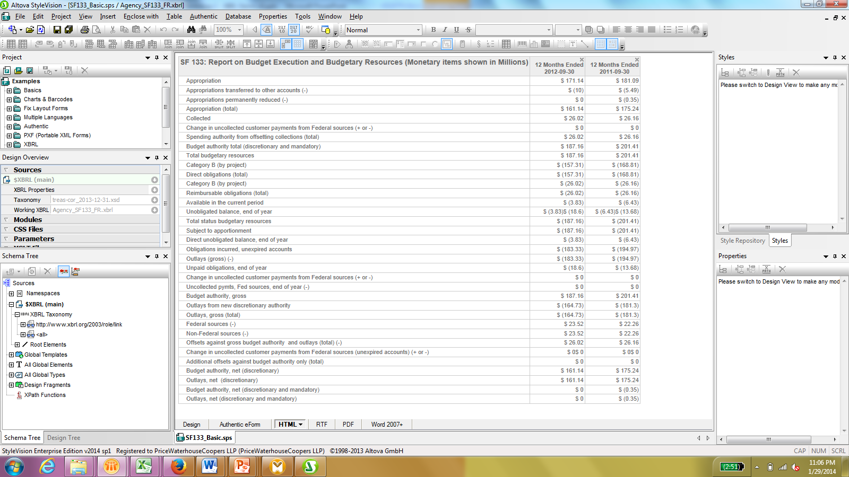
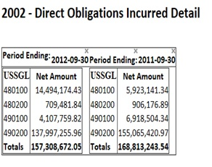
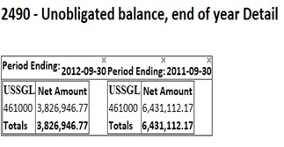
Data-Centric Approach Enables ‘Drill Down’
Notes:
Data is locked in silos. People spend too much time looking for information or too little time making decisions - based on incomplete information. This approach further enables the ability to drill down from summary information in the details and validate.

Slide 8
Intelligent Data Approach Establishes governance and structure over information assets across the U.S. Government and technological boundaries to improve quality efficiency, promote transparency and enable business insight.
Management Alignment
Strategic Objectives
Mission & Vision
Stewardship
Data Governance
Data Management
Data Quality
Architecture
Integration
Synchronization
Transformation
Metadata
Business Process Management
Design
Modeling
Execution
Monitoring
Optimization
Compliance Management
Policy
Standards
Privacy
Security
Business Rules
Risk Management
Sensitivity
People Management
People & Roles
Change Management
Communication
Ownership
Accountability
Collaboration
Content Management
Technology

Slide 9
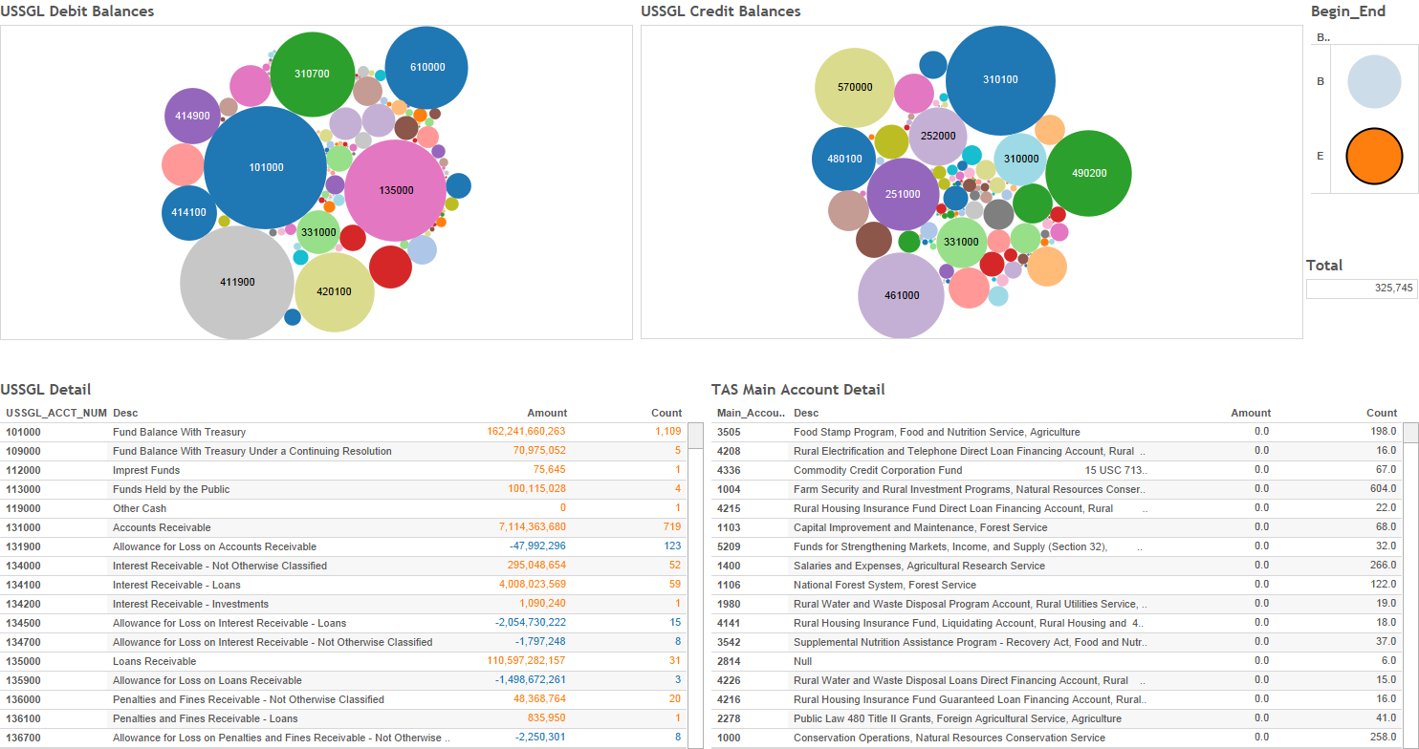
The USSGL by Debit and Credit
Notes:
This dashboard is designed to show the USSGL Debit and Credit amounts by Treasury Symbol with a filter to look at beginning or ending balances

Slide 10
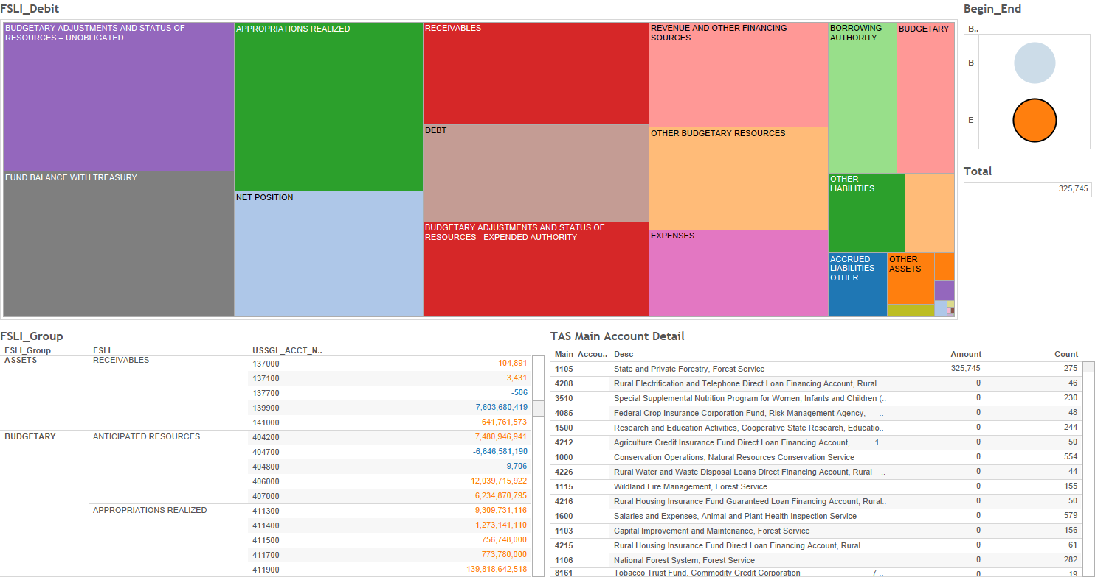
Applying a Different Lens
Notes:
This dashboard is designed to show the Financial Statement Line Item amounts by Treasury Symbol with a filter to look at beginning or ending balances

Slide 11
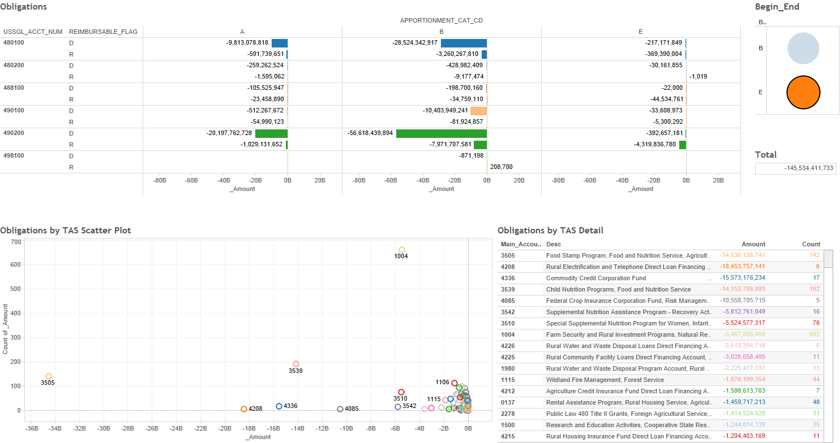
Obligations
Notes:
This dashboard is designed to show the Obligations amount by USSGL account, Direct/Reimbursable, Apportionment Category and Treasury Symbol with a filter to look at beginning or ending balances

Slide 12
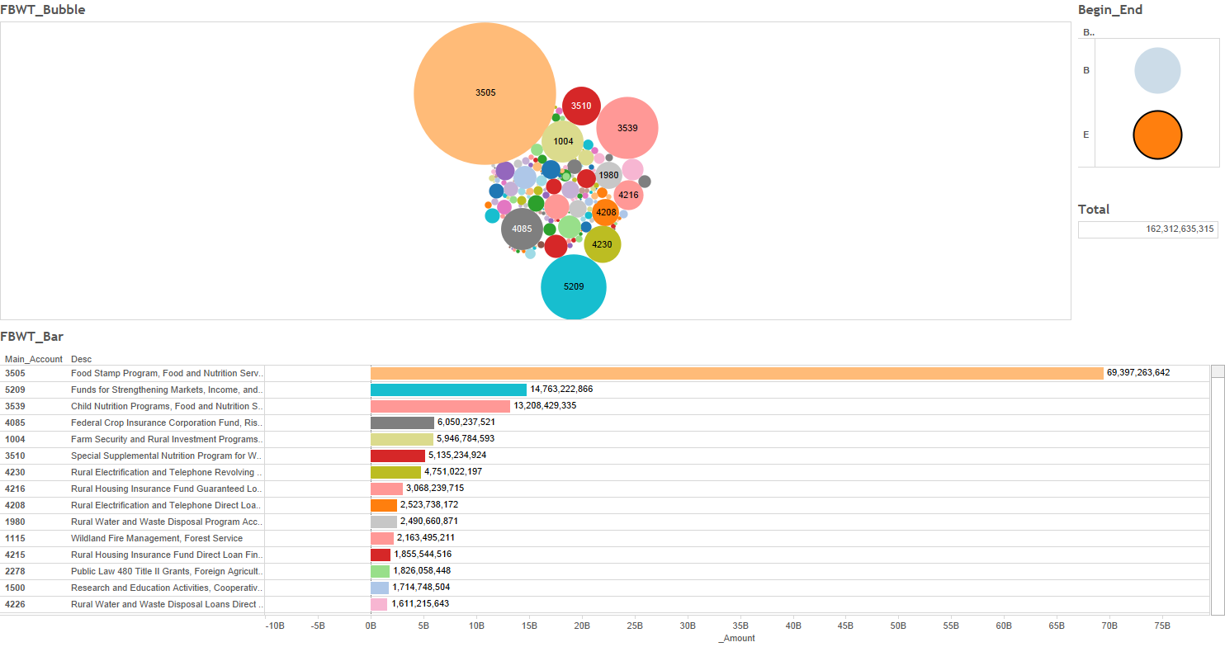
Fund Balance with Treasury Amount
Notes:
This dashboard is designed to show the Fund Balance with Treasury amount by Treasury Symbol with a filter to look at beginning or ending balances

Slide 13
Intelligent Data Benefits
Business
Sharing information across the U.S. Government through reusable reports and analysis.
Lower total cost of ownership
Technical
Better Business-IT alignment
Improved information management
DATA ACT compliance
Improved business agility
Reduced infrastructure complexity
Allows for planned incremental roll-out

